Slide 1
Introduction to Course Content

Slide 2
Overview of the Course
Week 1 | Propositional Logic
Week 2 | Predicate Logic
Week 3 | Proofs
Week 4 | Sets, Functions, Relations
Week 5 | Relations, Sequences, Summations
Week 6 | Algorithms
Week 7 | Complexity of Algorithms
Week 8 | Number Theory
Week 9 | Induction and Recursion
Week 10 | Counting
Week 11 | Advanced Counting
Week 12 | Probability
Week 13 | Advanced Probability

Slide 3
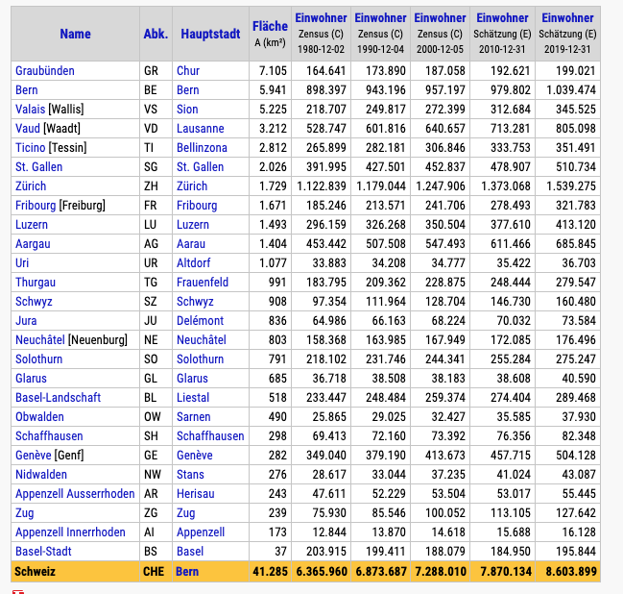
Example 1: Swiss Cities
We find a lot of tabular data, e.g. https://www.citypopulation.de/de/switzerland/cities/

Slide 4
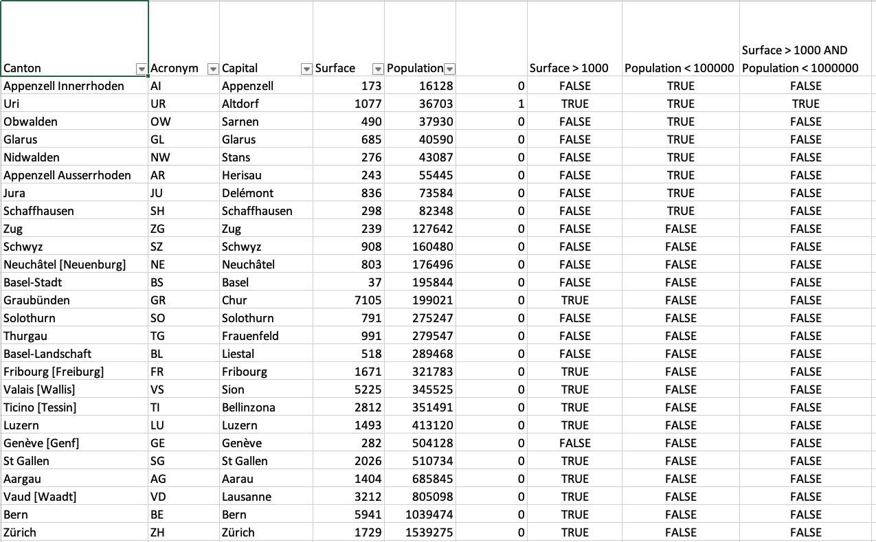
Load in Excel
Week 4 | Sets, Functions, Relations
ordered tuple
relation (a set)

Slide 5
Load in Excel
Week 1 | Propositional Logic
Week 2 | Predicate Logic
Week 4 | Sets, Functions, Relations
predicate
propositional connective
ordered tuple
truth table
relation (a set)

Slide 6
Functions
Week 1 | Propositional Logic
Week 2 | Predicate Logic
Week 4 | Sets, Functions, Relations
function: Canton -> Surface (every canton has a surface)
Not a function: Population -> Capital (population does not determine the canton)
injective function: Canton -> Capital (every canton has a different capital)
Not injective: Canton -> Population, different cantons may have same population

Slide 7
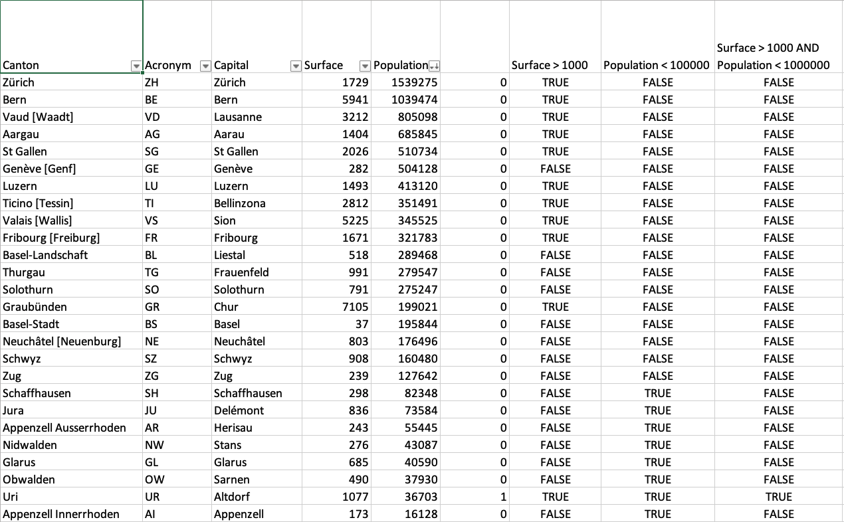
Sorting the Table
Week 5 | Relations, Sequences, Summations
Week 6 | Algorithms
Week 7 | Complexity of Algorithms
How did the computer sort?
A simple algorithm
Take the first
Take the second, put it into right position
Take the third, put it into right position
Etc.
How much time? (worst case complexity)
1 + 2 + 3 + … + n = n*(n-1)/2
a sequence and its summation
We can do much better: n log₂(n)
e.g. 1000 cities
n*(n-1)/2 approx. 500’000 steps
n log(n) approx. 10’000 steps

Slide 8
Example 2: Covid Infections
One person has Covid-19. A person can infect another person as from the second day after infection. From then on, the person will infect every day another person.
How many persons are infected after n days, assuming that persons never recover from the disease?

Slide 9
Calculation
Day 1:
Day 2:
Day 3:
Day 4:
Day 5:
Day 6:
…
Day n: persons from Day n-1 (existing ones) plus persons from Day n-2 (who can infect people)

Slide 10
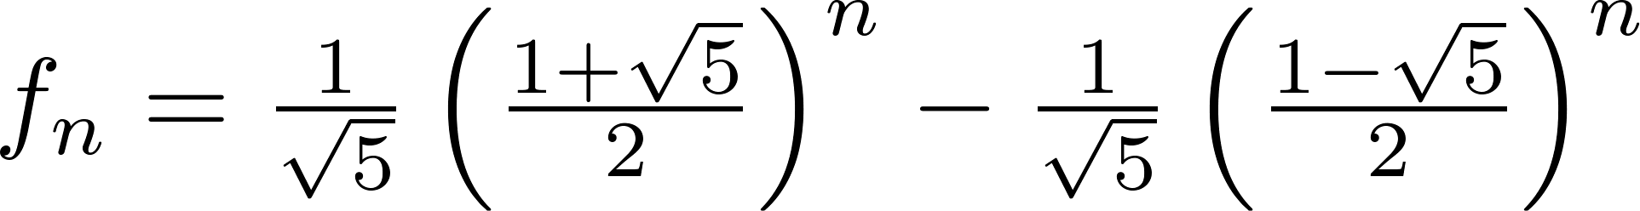
Writing it down
Week 5 | Relations, Sequences, Summations
Week 9 | Induction and Recursion
Week 11 | Advanced Counting
f_{n} = f_{n-1} + f_{n-2}, a recursion
But we can compute it directly (exponential growth)

Slide 11
Introducing Quarantaine
How many persons are infected after n days, assuming that persons are quarantained after 4 days? f_{n} = f_{n-1} + f_{n-2} - f_{n-4}
Logarithmic scale

Slide 12
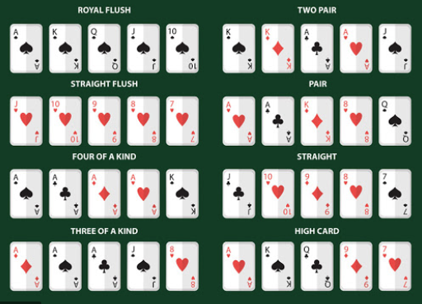
Example 3: Poker
Week 10 | Counting
How many poker hands of five cards can be dealt from a standard deck of 52 cards?
Simple: n₁ = 52*51*50*49*48 = 311875200
How many ways can you reorder five cards? (permutations)
Simple: n₂ = 5*4*3*2*1 = 120
How many different poker hands to exist (combinations)
n₁ / n₂ = 2598960

Slide 13
Full House
Week 10 | Counting
Week 12 | Probability
How many poker cards are full house (counting)?
13 kind of cards to select the three, e.g. Aces
4 ways to select three Aces (we have to skip one color)
12 kind of cards left for the pair
6 ways to select two cards out of 4 – (1,2)(1,3)(1,4)(2,3)(2,4)(3,4)
So in total 13 · 4 · 12 · 6 = 3744 ways to select a full house
What is the probability of a full house: approx. 0.15%

Slide 14
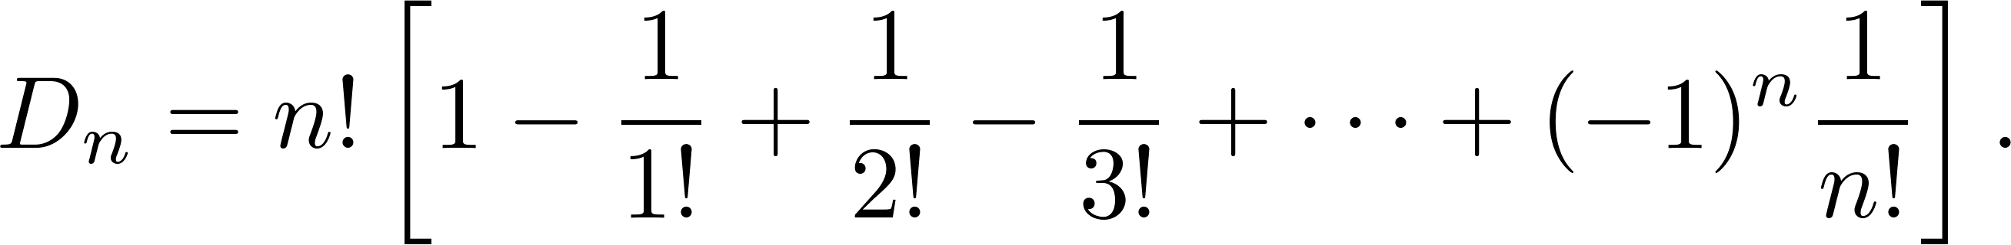
Poker
Week 10 | Advanced Counting
Week 12 | Advanced Probability
In how many ways can you change the order of 5 cards without leaving a card in the same position: 41
How many deals do you need have more than 50% chance of having a full house: about 31

Slide 15
Example 4: Primes
Week 8 | Number Theory
A prime is a number that can be divided only by itself and 1
Examples: 1, 2, 3, 5, 7, 11, 13, 17, …. , 2^{82,589,933} − 1, …..
Theorem: If n is an integer greater than 1, then n can be written as the product of primes (fundamental theorem of arithmetic)
Proof: not complicated but needs the principle of induction
24,862,048 digits (discovered December 2018)

Slide 16
Proof
Week 3 | Proofs
Week 8 | Number Theory
Week 9 | Induction and Recursion
True for n = 2: since 2 is a prime, it is a product of primes (one factor)
Now assume true for all integers 2 ≤ j ≤ k:
Two possibilities:
k+1 is prime, then k+1 is the product of (one) prime
k+1 is not prime. Then k+1 = a*b for two integers that are not 1 and not k+1. Therefore a and b are smaller or equal than k. But we have shown that then a and b can be written as product of primes. Therefore also k+1 is written as product of primes.
The principle of (strong) induction allows us now to conclude that the statement is true for any n.

Slide 17
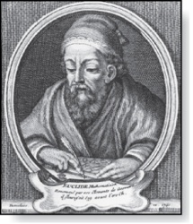
Number of Primes
Week 3 | Proofs
Week 8 | Number Theory
Theorem: There are infinitely many primes. (Euclid)
Proof Idea:
Assume there are only finitely many primes: p₁, p₂, ….., p_{n}
Let q = p₁*p₂*∙∙∙*p_{n} + 1
q would not be prime; using the fundamental theorem of arithmetic we can show that this leads to a contradiction (proof by contradiction)
Thus there are infinitely many primes.
Euclid
(325 B.C.E. – 265 B.C.E.)

Slide 18
Data, Life, Games & Numbers
Week 1 | Propositional Logic
Week 2 | Predicate Logic
Week 3 | Proofs
Week 4 | Sets, Functions, Relations
Week 5 | Relations, Sequences, Summations
Week 6 | Algorithms
Week 7 | Complexity of Algorithms
Week 8 | Number Theory
Week 9 | Induction and Recursion
Week 10 | Counting
Week 11 | Advanced Counting
Week 12 | Probability
Week 13 | Advanced Probability

